Slide 1

Pathways after high school - Central
Presentation of results – EPIC
August 26th, 2025

Slide 2


A fundamental shift is taking place in economic development
From Business Recruitment
To People Recruitment
This is a statewide issue!

Slide 3

What to do?
Invest in non-traditional economic development
Resident recruitment and retention initiatives
High school engagement
Child care
Housing
Engaging retired

Slide 4
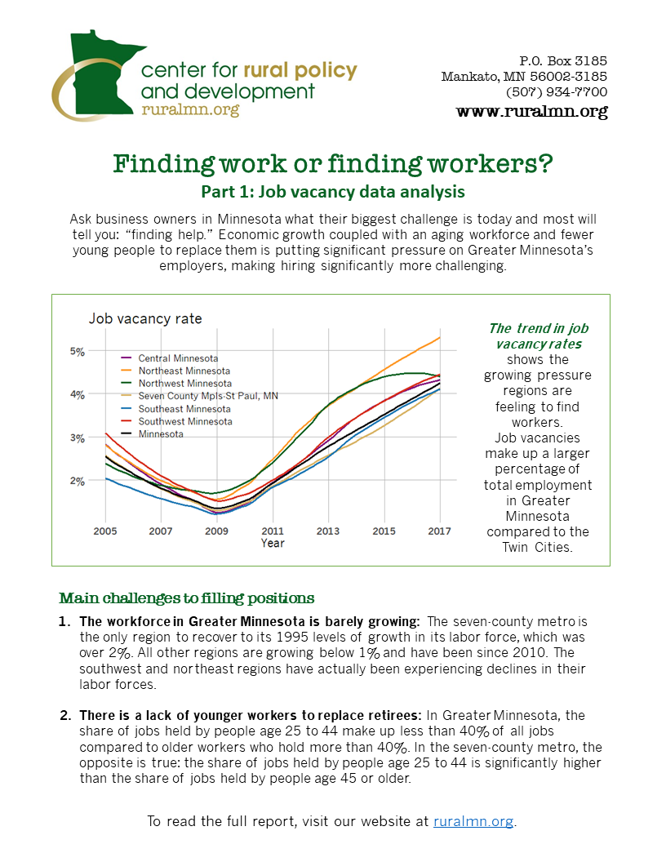



Rural Job Vacancy Report Series
Resident recruitment
Engaging high school students
The data
High barriers to employment

Slide 5

One completed report
Pathways after high school - Southwest

Slide 6
Project Regions
Northwest:
EDR 1
EDR 2
EDR 4
Northeast
EDR 3
Central
EDR 5
EDR 7E
EDR 7W
Southwest
EDR 6E
EDR 6W
EDR 8
Southern
EDR 9
EDR 10

Slide 7
The Data
Pathways after high school - Central
Presentation of Results – EPIC
August 26th, 2025

Slide 8
Project Initiation Overview
Request from Office of Higher Education – Meredith Ferguson, Research Director at OHE
Partners involved in project development
OHE
DEED MN Department of Education
SWWC Service Cooperative
Minnesota Valley Education District Consortium

Slide 9

Research Question
Among high school graduates, which educational experiences result in a higher probability of having local geographic workforce participation at Time X?

Slide 10
“Time X” = Years after graduation
2008
2009
2010
Etc…
1 year after graduating high school
2 years after graduating high school
3 years after graduating high school
Etc…

Slide 11
Time illustration
Student ID | 1 | 2 | 3 | 4 | 5 | 6
1 | 2009 | 2010 | 2011 | 2012 | 2013 | 2014
2 | 2011 | 2012 | 2013 | 2014 | 2015 | 2016
3 | 2016 | 2017 | 2018 | 2019 | - | -
4 | 2008 | 2009 | 2010 | 2011 | 2012 | 2013
5 | 2018 | 2019 | - | - | - | -

Slide 12
Population
High school graduate (2008 – 2023)
High schools with physical address in EDR 5, 7E, 7W (referred to as Central in report)
Years 2006 - 2019

Slide 13
Statewide Longitudinal Education Data System (SLEDS)
Individual
High school variables
Post-secondary variables
MN Employment records

Slide 14
The trends
Pathways after high school - Central
Presentation of Results – EPIC
August 26th, 2025

Slide 15

”Meaningful workforce participation”
1,000+ hours worked with single employer in calendar year.

Slide 16
Workforce participation “states” at Time X
Meaningful WF - Central
Meaningful WF – MN, not Central
Attending post-secondary
Not meaningful, not post-secondary (Part-time)
No MN employment record, no post-secondary

Slide 17
MN Statewide Longitudinal Education Data System (SLEDS)

Slide 18
MN Statewide Longitudinal Education Data System (SLEDS)

Slide 19
The predictors
Pathways after high school - Central
Presentation of Results – EPIC
August 26th, 2025

Slide 20
Analyze factors that contribute to these patterns
Individual characteristics
Gender
English Proficiency
SES: free or reduced lunch
Etc….
Community/High school characteristics
Unemployment
Wages in high school county
EDR
Etc….
Educational Accomplishments
CTE courses
ACT and other test scores
PSEO participant
Etc…..
Post-secondary Pathway
Institution type
Location
Highest credential earned
Etc….

Slide 21
Analysis Process
Identify similar variables
Multiple Correspondence Analysis
ID variables with largest impacts
CART Analysis
Identify differences within variables
Cross-tabs
Cramer’s test
Wilcoxon

Slide 22
Variables Ranked by Importance
Postsecondary graduation
Regional colleges = strongest tie to local employment
Credential earned
Associate or lower = higher local employment
Higher credential = more mobility, less regional attachment
High school accomplishments
CTE participate = feeds regional/associate pathways
PSEO, ACT, AP = feeds bachelor’s pathways, more likely to leave
Demographic and high school context
Economic disadvantage, race/ethnicity, rural vs. urban shape access to pathways
But not strong drivers once postsecondary outcomes are known

Slide 23

Key Themes
Local ties significantly increase the odds that an individual will have meaningful regional workforce participation.
There’s a disconnect in traditional educational paths and local careers.
There are students ”falling through the cracks”.

Slide 24
Takeaway #1
Local post-secondary pathways lead to local workforce employment

Slide 25
Local colleges supply meaningful employment
sdwed

Slide 26
Takeaway #2
Not enough students attending local colleges to fill local labor force needs

Slide 27
Few graduating from local colleges
Only 12.3% of high school graduates from 2008 to 2023 had graduated from a local college.
All students who were enrolled in post-secondary institution as of 2023 were removed.

Slide 28
Takeaway #2
Lower credentials tend to stay local

Slide 29
Associate or lesser benefits local employment
Of the individuals that earned an Associate or less credential, 31.1% of them had meaningful employment in the region. Of all the credentials (and non-credential) earners, this is the largest contributor to local employment.

Slide 30
Takeaway #4
Increasing the odds for regional workforce participation with Career and Technical Education and local career awareness

Slide 31
Why is CTE a local tie?
Defined as a “sequence of courses that integrates core academic knowledge with technical and occupational knowledge and skills to provide students a pathway to postsecondary education and careers”. (MDE)
Regional employers
DEED
Local communities
Local Colleges
Local High schools
Non-profits
Work-based learning

Slide 32
CTE Engagement leads to local meaningful employment
Of the CTE Concentrators, 26% had meaningful labor force participation in the region while 31% did in Minnesota, but outside the region.
It’s pretty much identical percentages for CTE participants.
Individuals with no CTE were significantly more likely to not have a MN employment record.

Slide 33
CTE impacts post-high school paths
Higher CTE engagement
Associate degree or less
Graduate from a Central College
Higher percentages
Higher proportion of individuals with meaningful workforce participation in SW
MN Statewide Longitudinal Education Data System (SLEDS)

Slide 34
Takeaway #5
Planning for advanced degrees increases odds for having meaningful workforce participation outside Central

Slide 35
College planning (ACT) impacts beyond meaningful workforce participation
ACT-takers & high MCA scores
Graduate college outside Central
Earn a bachelor degree
Graduate from 4-year college
Higher proportions
Higher proportion of individuals with meaningful workforce participation OUTSIDE SW
MN Statewide Longitudinal Education Data System (SLEDS)

Slide 36
Takeaway #6
Individuals not graduating post-secondary

Slide 37
Key Question
Why Leave if opportunities exist locally?

Slide 38
Disconnect
CTE
Central College
Associate's
Meaningful WF - Central
ACT / MCA
No college / College outside region
Bachelor's degree
Meaningful WF - outside Central
Local Ties

Slide 39
Why choose those paths?
Perceptions of opportunities
Local economy, unemployment
Distance to post-secondary institutions
Youth satisfaction with current community and importance of future community characteristics.
Youth are more likely to stay if they are satisfied with amenities, has desirable natural amenities, feel respected, and have a strong identification with the community.
Can also shape their desires in a future community.
Can influence educational aspirations
Influence of school, family and friends.
Support received to pursue their desires either locally or out-of-town/region.
Closeness can keep a student from leaving.
Family SES
Parents are critical purveyors of local economy
Expectations of educational attainment
Parents understanding of higher education
Aspirations and attributes of the individual youth
Self-efficacy
Race and ethnicity
From a rural area
Gender
Connection between youth and local opportunities.

Slide 40

Questions Kelly Asche email: kasche@ruralmn.org

